Slide 1

Welcome to the Circus
Juggling the
Student Aid Index (SAI)

Slide 2
Student Aid Index (SAI)
SAI replaced the EFC in the 2024-2025 Award Year
What is it?
SAI is an eligibility index number used to measure a student’s and their family’s ability to pay for postsecondary expenses.
What do we use it for?
COA – SAI = Financial Need
COA = Cost of Attendance
SAI = Student Aid Index
Tells us how much aid a student can have.
Tells us what kinds of aid a student can have.
Notes:
The SAI is not easy to squeeze into an hour, so before we start let’s look at the very basics you need to know about it.
Ability, not willingness
We use it to calculate Financial Need
When I explain this to families – magic numbers

Slide 3
Today’s Acts Include:
Which circus is right for me?
Which tent do I go in?
What happens behind the curtain?
SAI Formulas
SAI Flowchart
SAI Calculation
Notes:
1: SAI Formulas
2: SAI Flowchart
3. SAI Calculation
SAI Formula A/B/C
Which circus is right for me?
The best circus for you depends on your family. Who will be joining you determines the right circus for you!
SAI Flowchart
Which tent?
Once you arrive at the circus, the best tent for you to explore has already been determined. Let’s explore the map to find where you belong.
What happens behind the curtain?
In some tents, all you need to do is enter, and the show has already begun!
In others, our performers are hard at work creating the act you see. Let’s peek at what they do to make this happen!

Slide 4

Which Circus is Right for Me?
SAI Formula A, B, or C

Slide 5

Notes:
There are 3 different circus options – the right one depends on who is coming to the circus with you. However, there are strict rules determining who that is.

Slide 6






A
Dependent Student
Notes:
If you are bringing your parents, this is the circus for you!
Regardless if you have single parent, married parents, step parent, siblings, etc. If you are required to bring a parent with you, this circus is your only option.
But what if I don’t want to bring my parent?
This circus has very strict rules about who can and can’t attend the circus without a parent. If you meet any of these conditions, you would be an independent student and would attend circus B or C instead.
What conditions would allow you to go to the circus without your parent(s):
24+
Married
Grad Student
Active Duty
Veteran
Dependents
At any point since you turned 13:
Orphan
Ward
Foster Care
Emancipated Minor
Legal Guardianship
Unaccompanied homeless/at risk
Unusual Circumstance (Dependency Override)

Slide 7



B
Independent Student
No dependent(s) other than a spouse
Notes:
You meet an independent condition that lets you attend the circus without your parents. Now we need to know if you have dependents.
If not, or if your spouse is your only dependent. You will be attending Circus B.

Slide 8



C
Independent Student
Dependent(s) other than a spouse
Notes:
Finally, if you are independent, so you do not need to bring a parent with you, but you have dependents besides your spouse, you will be attending Circus C.

Slide 9
A
B
C
Dependent Student
Independent Student
No dependent(s) other than a spouse
Independent Student
Dependent(s) other than a spouse
Notes:
4 examples

Slide 10

A
B
C
Dependent Student
Independent Student
No dependent(s) other than a spouse
Independent Student
Dependent(s) other than a spouse
Notes:
Taylor is 20 years old, unmarried, and lives with their parents, who financially support them. Taylor is a full-time college student.
Which circus will they attend?
Circus A

Slide 11
A
B
C
Dependent Student
Independent Student
No dependent(s) other than a spouse
Independent Student
Dependent(s) other than a spouse
Notes:
Skylar is 23 years old, married, and raising two children with their spouse. Skylar is financially responsible for their household while attending college.
Which circus will they attend?
Circus C

Slide 12
A
B
C
Dependent Student
Independent Student
No dependent(s) other than a spouse
Independent Student
Dependent(s) other than a spouse
Notes:
Morgan is 21 years old and a U.S. military veteran. Morgan lives alone and pays for their own expenses while attending college.
Which circus will they attend?
Circus B

Slide 13
A
B
C
Dependent Student
Independent Student
No dependent(s) other than a spouse
Independent Student
Dependent(s) other than a spouse
Notes:
Alex is 22 years old and has a 2-year-old daughter. The child lives with the other parent, who provides most of the financial support. Alex attends college full-time and does not contribute significantly to the child's expenses.
Which circus will they attend?
Circus A

Slide 14
Which tent do I go in?
SAI Flowchart
Notes:
Once you arrive at the circus, the best tent for you to explore has already been determined. Let’s explore the map to find where you belong.

Slide 15
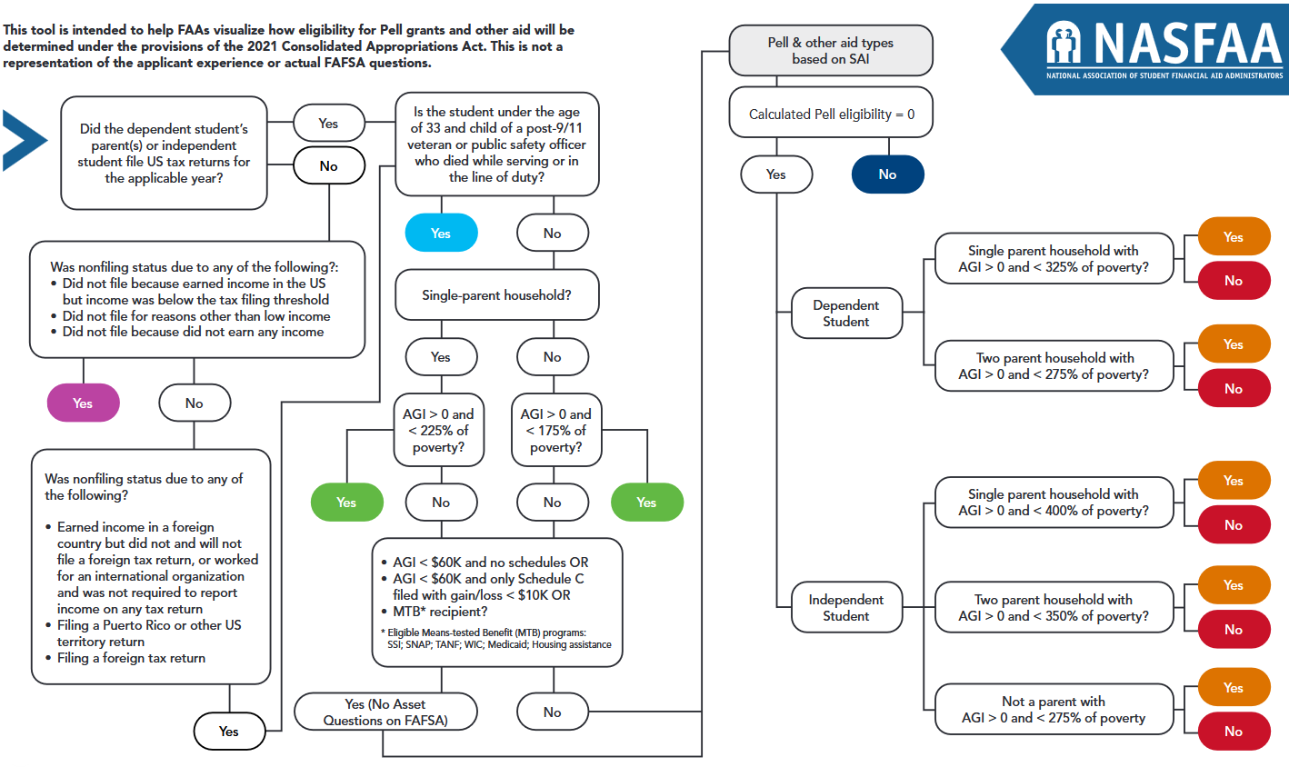
Maximum Pell
Maximum Pell
Maximum Pell
Auto -1500 SAI
Other aid types based on SAI
No asset questions on FAFSA
Auto 0 SAI
Other aid types based on SAI
No asset questions on FAFSA
Other aid types based on SAI
Calculated Pell
Other aid types based on SAI
Minimum Pell
Other aid types based on SAI
No Pell
Other aid types based on SAI
Notes:
Starting in the 2024-2025 award year, Pell Eligibility is not only determined by the SAI.
Instead, a student can qualify for Maximum Pell, Calculated Pell, Minimum Pell, or No Pell.
This might look familiar to you, but today it is our circus map, directing you to the tent you belong in. You should also have copies on each table.

Slide 16
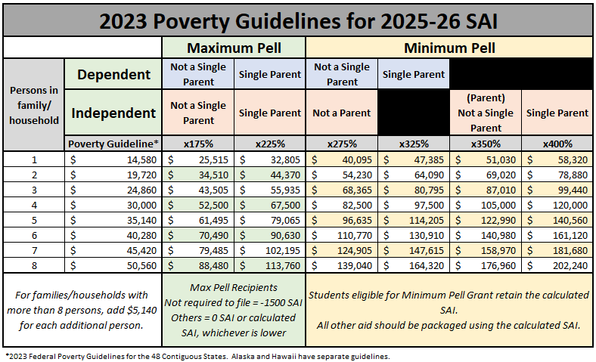
Notes:
This one won’t look as familiar. Most of the previous chart is determining whether the family’s AGI qualifies them for Pell. This chart is my preferred method of determining that and is also available on your tables.
You are going to use these 2 charts to determine which “tent” each of our circus guests will enter.

Slide 17

Maximum Pell
Maximum Pell
Maximum Pell
Auto -1500 SAI
Other aid types based on SAI
No asset questions on FAFSA
Auto 0 SAI
Other aid types based on SAI
No asset questions on FAFSA
Other aid types based on SAI
Calculated Pell
Other aid types based on SAI
Minimum Pell
Other aid types based on SAI
No Pell
Other aid types based on SAI
Aria
27 years old
Married with no dependents
Aria and her spouse filed jointly.
AGI of $52,000.
Notes:
Did Aria file taxes? Yes
Did Aria have a parent killed in the line of duty? No
Is Aria in a single-parent household? No
Is her AGI under 175% of the poverty guideline?
At this point we’re going to jump to our other chart.

Slide 18
Notes:
Aria is an independent student. With a family size of 2. She is not a parent.
Since Aria is at Circus B, she does not have an option to qualify for Maximum Pell due to AGI. This is only available for non filers, or parents (attending Circus A or C)
Her AGI is $52,000, which is less than 275% of the federal poverty guidelines. She qualifies for minimum pell.

Slide 19

Maximum Pell
Maximum Pell
Maximum Pell
Auto -1500 SAI
Other aid types based on SAI
No asset questions on FAFSA
Auto 0 SAI
Other aid types based on SAI
No asset questions on FAFSA
Other aid types based on SAI
Calculated Pell
Other aid types based on SAI
Minimum Pell
Other aid types based on SAI
No Pell
Other aid types based on SAI
Aria
27 years old
Married with no dependents
Aria and her spouse filed jointly.
AGI of $52,000.
Notes:
So if we finish out our chart, we will see that she might qualify for calculated Pell. We won’t know for sure until we do the SAI calculation, for this exercise, we’re going to assume she did not qualify for calculated Pell, so then we move along and find her income threshold to see she will receive minimum Pell.

Slide 20
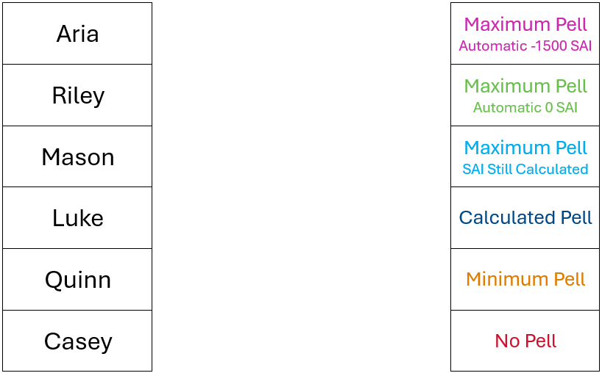
Notes:
I’m going to give you 5 minutes now to work through the rest of our examples.

Slide 21
5
4
3
2
1

Slide 22
Notes:
I’m going to give you 5 minutes now to work through the rest of our examples.

Slide 23
Maximum Pell
Maximum Pell
Maximum Pell
Auto -1500 SAI
Other aid types based on SAI
No asset questions on FAFSA
Auto 0 SAI
Other aid types based on SAI
No asset questions on FAFSA
Other aid types based on SAI
Calculated Pell
Other aid types based on SAI
Minimum Pell
Other aid types based on SAI
No Pell
Other aid types based on SAI
Notes:
Our examples skipped over this (under green) section. This part is essentially checking to see if you need to answer the asset questions.
If you have an AGI of under $60K, with either no schedules, or only a schedule C showing a gain/loss of less than $10K or you are a recipient of Means Tested Benefits (SSI, SNAP, TANF, WIC, Medicaid, Housing Assistance) then you will automatically receive max Pell and the asset questions will not be considered on the FAFSA.
This is where we may see a business owner or farmer, with millions of dollars in assets, who qualifies for a maximum Pell grant. Because their AGI already put them into one of these “tents”, the assets are not relevant.
We may also see those who don’t qualify for asset exemptions here, but still land in the minimum Pell Grant tent. In that case, their assets would be considered for their AGI, but even if their SAI ends up calculating at 999,999, they still have that minimum Pell indicator, which was based on their AGI.

Slide 24
What happens behind the curtain?
SAI Calculation
Notes:
Now that we’ve found the right circus for us, and used the map to figure out which tent we’re heading for it’s time to actually enjoy the show!
To truly understand the SAI, a hand calculation is your best bet. We are going to dive into one together today and will learn as we go through it. I recommend doing an in depth one at least annually.

Slide 25
Maximum Pell
Maximum Pell
Maximum Pell
Auto -1500 SAI
Other aid types based on SAI
No asset questions on FAFSA
Auto 0 SAI
Other aid types based on SAI
No asset questions on FAFSA
Other aid types based on SAI
Calculated Pell
Other aid types based on SAI
Minimum Pell
Other aid types based on SAI
No Pell
Other aid types based on SAI
Notes:
Remember, these 2 tents, skip the SAI Calculation.
No magic tricks or smoke and mirrors.
If you enter the pink tent you have a -1500 SAI, all of your aid is based on that.
If you enter the green tent, you have a 0 SAI, all of your aid is based on that.

Slide 26
Maximum Pell
Maximum Pell
Maximum Pell
Auto -1500 SAI
Other aid types based on SAI
No asset questions on FAFSA
Auto 0 SAI
Other aid types based on SAI
No asset questions on FAFSA
Other aid types based on SAI
Calculated Pell
Other aid types based on SAI
Minimum Pell
Other aid types based on SAI
No Pell
Other aid types based on SAI
Notes:
We’re also not going to focus too much on our light blue tent, because of how rare it is. Just know these students would still get an SAI. They would get a Full Pell grant, but all of their other aid will follow their calculated SAI.

Slide 27
Maximum Pell
Maximum Pell
Maximum Pell
Auto -1500 SAI
Other aid types based on SAI
No asset questions on FAFSA
Auto 0 SAI
Other aid types based on SAI
No asset questions on FAFSA
Other aid types based on SAI
Calculated Pell
Other aid types based on SAI
Minimum Pell
Other aid types based on SAI
No Pell
Other aid types based on SAI
Notes:
Instead, from here on out, we will be looking at our dark blue, orange, and red tents: Calculated Pell, Minimum Pell, and No Pell.
These tents are where our students enjoy the show and see the final result: their SAI. We are going to look behind the curtain though and see where that SAI comes from.

Slide 28
A
B
C
Dependent Student
Independent Student
No dependent(s) other than a spouse
Independent Student
Dependent(s) other than a spouse
Notes:
Remember, we have 3 different circuses to attend based on the student and their family

Slide 29
A
B
C
Parent Contribution from Income
Parent Income Additions
Parent Income Offsets
Parent Contribution from Assets
Parent Adjusted Available Income
Parent Contribution
Allowances Against Parents’ Income
Parents’ Available Income
Total Parent Contribution
Student Contribution from Income
Student Income Additions
Student Income Offsets
Student Contribution from Assets
Parent Contribution
Student Contribution from Income
Allowances Against Students’ Income
Student’s Contribution from Income
Student Aid Index
Student Contribution from Assets
Student Contribution from Income
Student Income Additions
Student Income Offsets
Student Contribution from Assets
Student Contribution from Income
Student Contribution from Assets
Allowances Against Student Income
Student’s Contribution from Income
Student Aid Index
Student Contribution from Income
Student Income Additions
Student Income Offsets
Student Contribution from Assets
Student Contribution from Income
Student Contribution from Assets
Allowances Against Student Income
Student’s Available Income
Student Aid Index
Notes:
Inside, each circus has a calculation they will perform. Circus A, has 2 parts, the student and the parent. Circus B and C each have just one portion, which contains the student, and their spouse, if applicable.
All 3 (or 4 if you think of A as 2 formulas) are very similar, the main differences are different percentages or tables used to find some values used in the calculation.
Since we are limited on time, we are only going to visit Circus A today, because it’s the most complicated, due to a parent and student portion.

Slide 30
A
B
C
Parent Contribution from Income
Parent Income Additions
Parent Income Offsets
Parent Contribution from Assets
Parent Adjusted Available Income
Parent Contribution
Allowances Against Parents’ Income
Parents’ Available Income
Total Parent Contribution
Student Contribution from Income
Student Income Additions
Student Income Offsets
Student Contribution from Assets
Parent Contribution
Student Contribution from Income
Allowances Against Students’ Income
Student’s Contribution from Income
Student Aid Index
Student Contribution from Assets
Student Contribution from Income
Student Income Additions
Student Income Offsets
Student Contribution from Assets
Student Contribution from Income
Student Contribution from Assets
Allowances Against Student Income
Student’s Contribution from Income
Student Aid Index
Student Contribution from Income
Student Income Additions
Student Income Offsets
Student Contribution from Assets
Student Contribution from Income
Student Contribution from Assets
Allowances Against Student Income
Student’s Available Income
Student Aid Index
Notes:
As we move on, I want you to notice the word CONTRIBUTION.
This word is important because in each step, we are not asking anyone to contribute ALL of their income or their assets, we are asking them to contribute a portion.

Slide 31
There are 2 steps in assessing ability to pay:
Measuring the family’s financial strength or wealth.
Assessing a portion of the family’s financial resources as being available to contribute towards the costs of the student’s education.
Notes:
So how do we get the contribution?
1st we figure out what the student or family’s financial strength is, in other words, how much are they earning and how much do they already have available to them.
2nd we use the protections and allowances to decide what portion of that could realistically go towards the student’s education costs, while still leaving the family enough money to live on

Slide 32


Contribution from Income
Contribution from Assets
Student Aid Index
Notes:
In it’s simplest form, the SAI is made up of the contribution from Income and Contribution from Assets
So we figure out the income, then we figure out how much of that can be used
Then we figure out the assets, and figure out how much of that can be used
When we add those together we get the SAI

Slide 33
Parent Contribution from Income
Parent Contribution from Assets
Parent Contribution
Student Contribution from Income
Student Contribution from Assets
Student Contribution
Student Aid Index
Notes:
For a dependent student, we do this for both the parent and the student, then we add their contributions together.

Slide 34


P.T. Barnam | Parents | Student
Marital Status | Married | Single
Tax Filing Status | Married-Filed Joint | Did not File
Age | 55/52 | 18
Family Size | 7
Adjusted Gross Income | $80,000 | $0
Income Earned From Work | $75,000 | $10,000
Federal Work Study | $0 | $1,500
Income Tax Paid | $5,000 | $0
Education Credits | $2,500 | $0
Untaxed Portions of IRA Distribution | $0 | $0
Deductible Payments to IRA/KEOGH/Other | $500 | $0
Tax Exempt Interest Income | $0 | $0
Untaxed Portions of Pensions | $0 | $0
Schedule C Net Profit/Loss | $0 | $0
Taxable College Grant and Scholarship Aid | $0 | $0
Foreign Income Exclusion | $0 | $0
Child Support Received | $0 | $0
Cash/Checking/Savings | $1,500 | $500
Net Worth of Business/Farm | $10,000 | $0
Net Worth of Investments | $0 | $0
A
Dependent Student
Notes:
Meet P.T. Barnum, our student for today.
Once we get to it, the SAI hand calc is really just plugging in numbers and some basic math. As we plug numbers in we’ll talk about why they’re going in each area.
P.T. is 18, he lives with his parents and 4 younger siblings. He does not meet any independent criteria.
Which circus is he going to? Why?
Circus A

Slide 35
Maximum Pell
Maximum Pell
Maximum Pell
Auto -1500 SAI
Other aid types based on SAI
No asset questions on FAFSA
Auto 0 SAI
Other aid types based on SAI
No asset questions on FAFSA
Other aid types based on SAI
Calculated Pell
Other aid types based on SAI
Minimum Pell
Other aid types based on SAI
No Pell
Other aid types based on SAI
Notes:
Which tent is P.T. going into?
His parents filed taxes.
Neither parent was killed in the line of duty.
He is from a 2 parent household.
Is his parents’ AGI less than 175% of the poverty line?

Slide 36
Notes:
Dependent student
Family size of 7
2 parent household
AGI is 80,000
Does not qualify for Automatic Max Pell, might qualify for Minimum

Slide 37

Maximum Pell
Maximum Pell
Maximum Pell
Auto -1500 SAI
Other aid types based on SAI
No asset questions on FAFSA
Auto 0 SAI
Other aid types based on SAI
No asset questions on FAFSA
Other aid types based on SAI
Calculated Pell
Other aid types based on SAI
Minimum Pell
Other aid types based on SAI
No Pell
Other aid types based on SAI
Notes:
Which tent is P.T. going into?
His parents filed taxes.
Neither parent was killed in the line of duty.
He is from a 2 parent household.
Is his parents’ AGI less than 175% of the poverty line?

Slide 38


Parent Contribution from Income
Notes:
Let’s look first at the Contribution from Income
Remember, we are finding the total, then determining what amount of that can be used towards educational costs

Slide 39
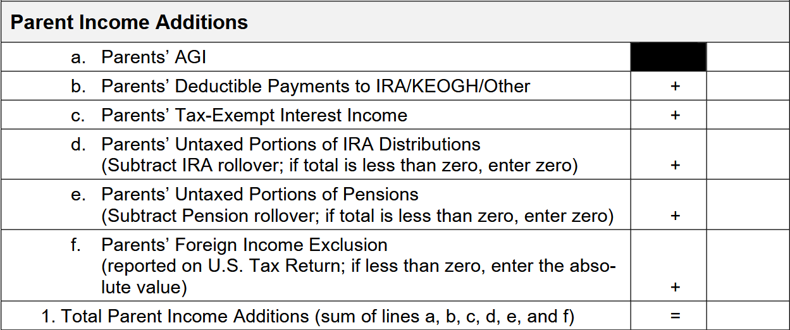

Parent Contribution From Income
P.T. Barnam | Parents | Student
Marital Status | Married | Single
Tax Filing Status | Married-Filed Joint | Did not File
Age | 55/52 | 18
Family Size | 7
Adjusted Gross Income | $80,000 | $0
Income Earned From Work | $75,000 | $10,000
Federal Work Study | $0 | $1,500
Income Tax Paid | $5,000 | $0
Education Credits | $2,500 | $0
Untaxed Portions of IRA Distribution | $0 | $0
Deductible Payments to IRA/KEOGH/Other | $500 | $0
Tax Exempt Interest Income | $0 | $0
Untaxed Portions of Pensions | $0 | $0
Schedule C Net Profit/Loss | $0 | $0
Taxable College Grant and Scholarship Aid | $0 | $0
Foreign Income Exclusion | $0 | $0
Child Support Received | $0 | $0
Cash/Checking/Savings | $1,500 | $500
Net Worth of Business/Farm | $10,000 | $0
Net Worth of Investments | $0 | $0
80,000
500
0
0
0
0
80,500
Taxed and Untaxed Income available to the parent(s)
Notes:
We’re going to keep our important numbers handy here.
First up is the parent’s contribution from income, starting with Parent Income Additions.
These are taxed and untaxed income available to the parents. We are simply grabbing them from the taxes, plugging them into our formula and adding them together.

Slide 40
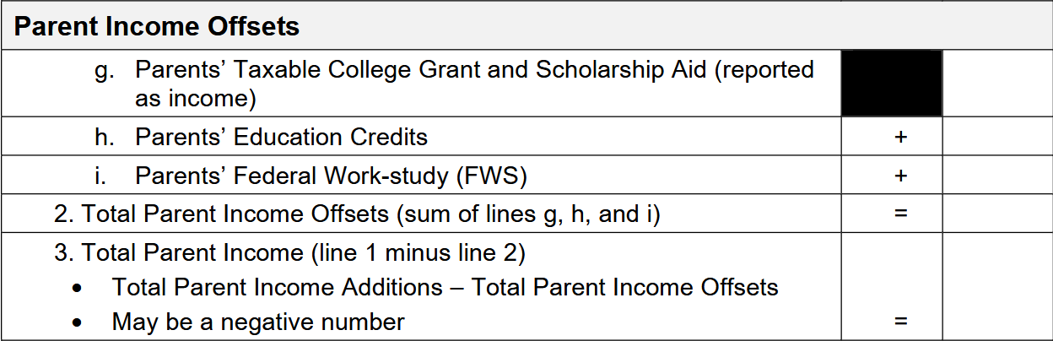
Parent Contribution From Income
P.T. Barnam | Parents | Student
Marital Status | Married | Single
Tax Filing Status | Married-Filed Joint | Did not File
Age | 55/52 | 18
Family Size | 7
Adjusted Gross Income | $80,000 | $0
Income Earned From Work | $75,000 | $10,000
Federal Work Study | $0 | $1,500
Income Tax Paid | $5,000 | $0
Education Credits | $2,500 | $0
Untaxed Portions of IRA Distribution | $0 | $0
Deductible Payments to IRA/KEOGH/Other | $500 | $0
Tax Exempt Interest Income | $0 | $0
Untaxed Portions of Pensions | $0 | $0
Schedule C Net Profit/Loss | $0 | $0
Taxable College Grant and Scholarship Aid | $0 | $0
Foreign Income Exclusion | $0 | $0
Child Support Received | $0 | $0
Cash/Checking/Savings | $1,500 | $500
Net Worth of Business/Farm | $10,000 | $0
Net Worth of Investments | $0 | $0
0
2,500
0
2,500
80,500
- 2,500
78,000
Income that is subtracted out of the calculation
These items are removed, or offset, to avoid penalizing families for utilizing resources intended to make college more affordable.
Notes:
Next up, Parent Income Offsets
These items are removed, or offset, to avoid penalizing families for utilizing resources intended to make college more affordable.

Slide 41
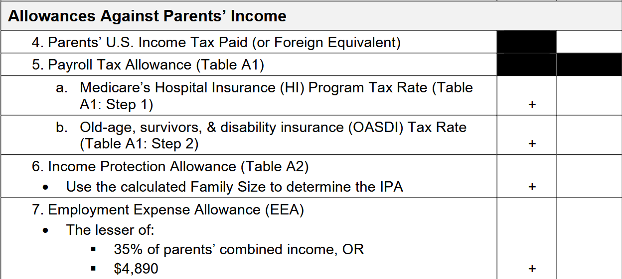
Parent Contribution From Income
P.T. Barnam | Parents | Student
Marital Status | Married | Single
Tax Filing Status | Married-Filed Joint | Did not File
Age | 55/52 | 18
Family Size | 7
Adjusted Gross Income | $80,000 | $0
Income Earned From Work | $75,000 | $10,000
Federal Work Study | $0 | $1,500
Income Tax Paid | $5,000 | $0
Education Credits | $2,500 | $0
Untaxed Portions of IRA Distribution | $0 | $0
Deductible Payments to IRA/KEOGH/Other | $500 | $0
Tax Exempt Interest Income | $0 | $0
Untaxed Portions of Pensions | $0 | $0
Schedule C Net Profit/Loss | $0 | $0
Taxable College Grant and Scholarship Aid | $0 | $0
Foreign Income Exclusion | $0 | $0
Child Support Received | $0 | $0
Cash/Checking/Savings | $1,500 | $500
Net Worth of Business/Farm | $10,000 | $0
Net Worth of Investments | $0 | $0
5,000
Money not available to pay for educational expenses because it is already being used for other purposes.
Notes:
Allowances against parents’ income
Money not available to pay for educational expenses because it is already being used for other purposes.

Slide 42
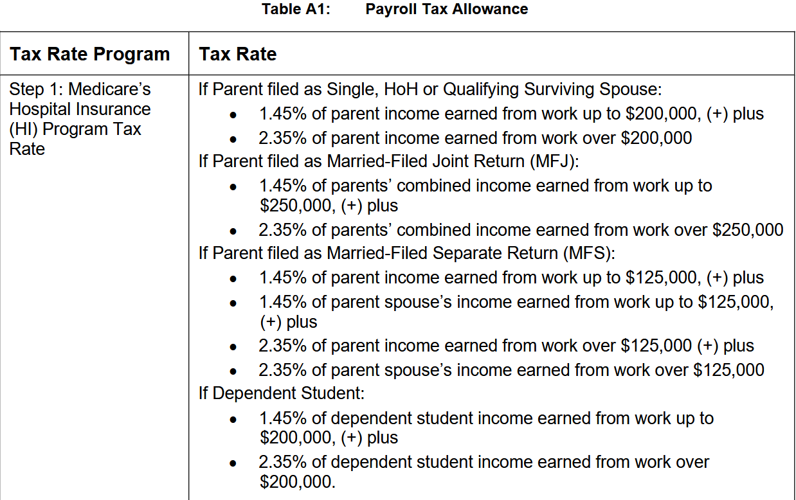
Parent Contribution From Income
P.T. Barnam | Parents | Student
Marital Status | Married | Single
Tax Filing Status | Married-Filed Joint | Did not File
Age | 55/52 | 18
Family Size | 7
Adjusted Gross Income | $80,000 | $0
Income Earned From Work | $75,000 | $10,000
Federal Work Study | $0 | $1,500
Income Tax Paid | $5,000 | $0
Education Credits | $2,500 | $0
Untaxed Portions of IRA Distribution | $0 | $0
Deductible Payments to IRA/KEOGH/Other | $500 | $0
Tax Exempt Interest Income | $0 | $0
Untaxed Portions of Pensions | $0 | $0
Schedule C Net Profit/Loss | $0 | $0
Taxable College Grant and Scholarship Aid | $0 | $0
Foreign Income Exclusion | $0 | $0
Child Support Received | $0 | $0
Cash/Checking/Savings | $1,500 | $500
Net Worth of Business/Farm | $10,000 | $0
Net Worth of Investments | $0 | $0
75,000
x 1.45%
1,087.50
Round to
1,088

Slide 43
Parent Contribution From Income
P.T. Barnam | Parents | Student
Marital Status | Married | Single
Tax Filing Status | Married-Filed Joint | Did not File
Age | 55/52 | 18
Family Size | 7
Adjusted Gross Income | $80,000 | $0
Income Earned From Work | $75,000 | $10,000
Federal Work Study | $0 | $1,500
Income Tax Paid | $5,000 | $0
Education Credits | $2,500 | $0
Untaxed Portions of IRA Distribution | $0 | $0
Deductible Payments to IRA/KEOGH/Other | $500 | $0
Tax Exempt Interest Income | $0 | $0
Untaxed Portions of Pensions | $0 | $0
Schedule C Net Profit/Loss | $0 | $0
Taxable College Grant and Scholarship Aid | $0 | $0
Foreign Income Exclusion | $0 | $0
Child Support Received | $0 | $0
Cash/Checking/Savings | $1,500 | $500
Net Worth of Business/Farm | $10,000 | $0
Net Worth of Investments | $0 | $0
5,000
1,088
Money not available to pay for educational expenses because it is already being used for other purposes.

Slide 44
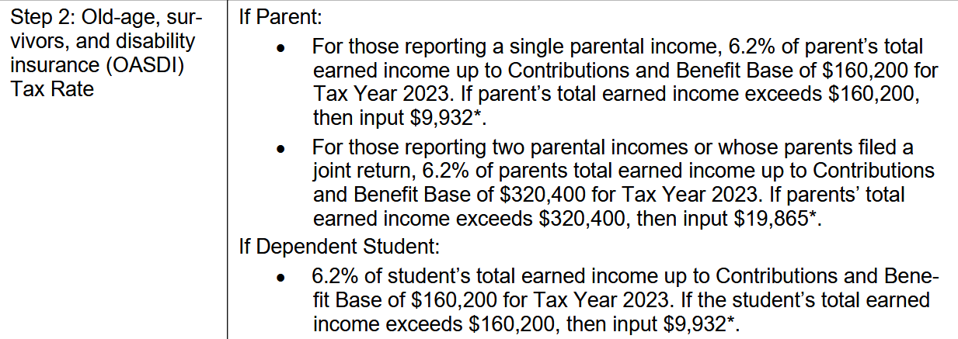
Parent Contribution From Income
P.T. Barnam | Parents | Student
Marital Status | Married | Single
Tax Filing Status | Married-Filed Joint | Did not File
Age | 55/52 | 18
Family Size | 7
Adjusted Gross Income | $80,000 | $0
Income Earned From Work | $75,000 | $10,000
Federal Work Study | $0 | $1,500
Income Tax Paid | $5,000 | $0
Education Credits | $2,500 | $0
Untaxed Portions of IRA Distribution | $0 | $0
Deductible Payments to IRA/KEOGH/Other | $500 | $0
Tax Exempt Interest Income | $0 | $0
Untaxed Portions of Pensions | $0 | $0
Schedule C Net Profit/Loss | $0 | $0
Taxable College Grant and Scholarship Aid | $0 | $0
Foreign Income Exclusion | $0 | $0
Child Support Received | $0 | $0
Cash/Checking/Savings | $1,500 | $500
Net Worth of Business/Farm | $10,000 | $0
Net Worth of Investments | $0 | $0
75,000
x 6.2%
4,650

Slide 45
Parent Contribution From Income
P.T. Barnam | Parents | Student
Marital Status | Married | Single
Tax Filing Status | Married-Filed Joint | Did not File
Age | 55/52 | 18
Family Size | 7
Adjusted Gross Income | $80,000 | $0
Income Earned From Work | $75,000 | $10,000
Federal Work Study | $0 | $1,500
Income Tax Paid | $5,000 | $0
Education Credits | $2,500 | $0
Untaxed Portions of IRA Distribution | $0 | $0
Deductible Payments to IRA/KEOGH/Other | $500 | $0
Tax Exempt Interest Income | $0 | $0
Untaxed Portions of Pensions | $0 | $0
Schedule C Net Profit/Loss | $0 | $0
Taxable College Grant and Scholarship Aid | $0 | $0
Foreign Income Exclusion | $0 | $0
Child Support Received | $0 | $0
Cash/Checking/Savings | $1,500 | $500
Net Worth of Business/Farm | $10,000 | $0
Net Worth of Investments | $0 | $0
5,000
1,088
4,650
Money not available to pay for educational expenses because it is already being used for other purposes.

Slide 46
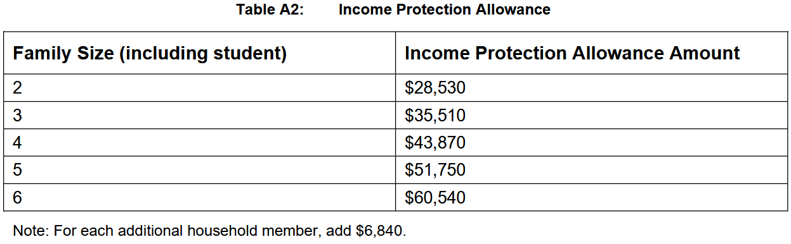
Parent Contribution From Income
P.T. Barnam | Parents | Student
Marital Status | Married | Single
Tax Filing Status | Married-Filed Joint | Did not File
Age | 55/52 | 18
Family Size | 7
Adjusted Gross Income | $80,000 | $0
Income Earned From Work | $75,000 | $10,000
Federal Work Study | $0 | $1,500
Income Tax Paid | $5,000 | $0
Education Credits | $2,500 | $0
Untaxed Portions of IRA Distribution | $0 | $0
Deductible Payments to IRA/KEOGH/Other | $500 | $0
Tax Exempt Interest Income | $0 | $0
Untaxed Portions of Pensions | $0 | $0
Schedule C Net Profit/Loss | $0 | $0
Taxable College Grant and Scholarship Aid | $0 | $0
Foreign Income Exclusion | $0 | $0
Child Support Received | $0 | $0
Cash/Checking/Savings | $1,500 | $500
Net Worth of Business/Farm | $10,000 | $0
Net Worth of Investments | $0 | $0
60,540
+ 6,840
67,380
Notes:
Income Protection Allowance accounts for a family’s basic living expenses.

Slide 47
Parent Contribution From Income
P.T. Barnam | Parents | Student
Marital Status | Married | Single
Tax Filing Status | Married-Filed Joint | Did not File
Age | 55/52 | 18
Family Size | 7
Adjusted Gross Income | $80,000 | $0
Income Earned From Work | $75,000 | $10,000
Federal Work Study | $0 | $1,500
Income Tax Paid | $5,000 | $0
Education Credits | $2,500 | $0
Untaxed Portions of IRA Distribution | $0 | $0
Deductible Payments to IRA/KEOGH/Other | $500 | $0
Tax Exempt Interest Income | $0 | $0
Untaxed Portions of Pensions | $0 | $0
Schedule C Net Profit/Loss | $0 | $0
Taxable College Grant and Scholarship Aid | $0 | $0
Foreign Income Exclusion | $0 | $0
Child Support Received | $0 | $0
Cash/Checking/Savings | $1,500 | $500
Net Worth of Business/Farm | $10,000 | $0
Net Worth of Investments | $0 | $0
5,000
1,088
4,650
67,380
75,000
x 35%
25,250
4,890
83,008
Money not available to pay for educational expenses because it is already being used for other purposes.
Notes:
Employment Expense Allowance - Expenses incurred by families with working parents – clothing, meals, transportation, etc

Slide 48
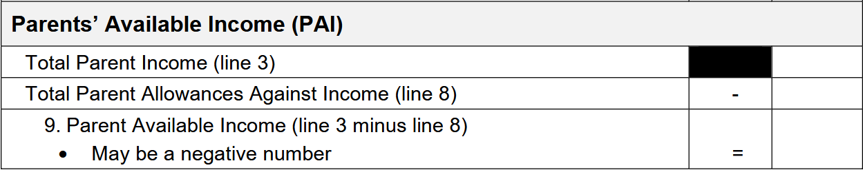
Parent Contribution From Income
P.T. Barnam | Parents | Student
Marital Status | Married | Single
Tax Filing Status | Married-Filed Joint | Did not File
Age | 55/52 | 18
Family Size | 7
Adjusted Gross Income | $80,000 | $0
Income Earned From Work | $75,000 | $10,000
Federal Work Study | $0 | $1,500
Income Tax Paid | $5,000 | $0
Education Credits | $2,500 | $0
Untaxed Portions of IRA Distribution | $0 | $0
Deductible Payments to IRA/KEOGH/Other | $500 | $0
Tax Exempt Interest Income | $0 | $0
Untaxed Portions of Pensions | $0 | $0
Schedule C Net Profit/Loss | $0 | $0
Taxable College Grant and Scholarship Aid | $0 | $0
Foreign Income Exclusion | $0 | $0
Child Support Received | $0 | $0
Cash/Checking/Savings | $1,500 | $500
Net Worth of Business/Farm | $10,000 | $0
Net Worth of Investments | $0 | $0
78,000
83,008
-5,008
Parent Available Income = Income available for discretionary purposes, including paying for a postsecondary education
Notes:
So we found what income the parents have, then we protected portions because:
Some types of income is not counted against you in the SAI formula (work study, taxable grants, scholarships)
Some income is not available to pay for educational expenses (taxes, basic living expenses)
This gives us the Parent Available Income

Slide 49
Parent Contribution from Assets
Notes:
Next, the Contribution from Assets
Again, we are finding the total, then determining what amount of that can be used towards educational costs

Slide 50
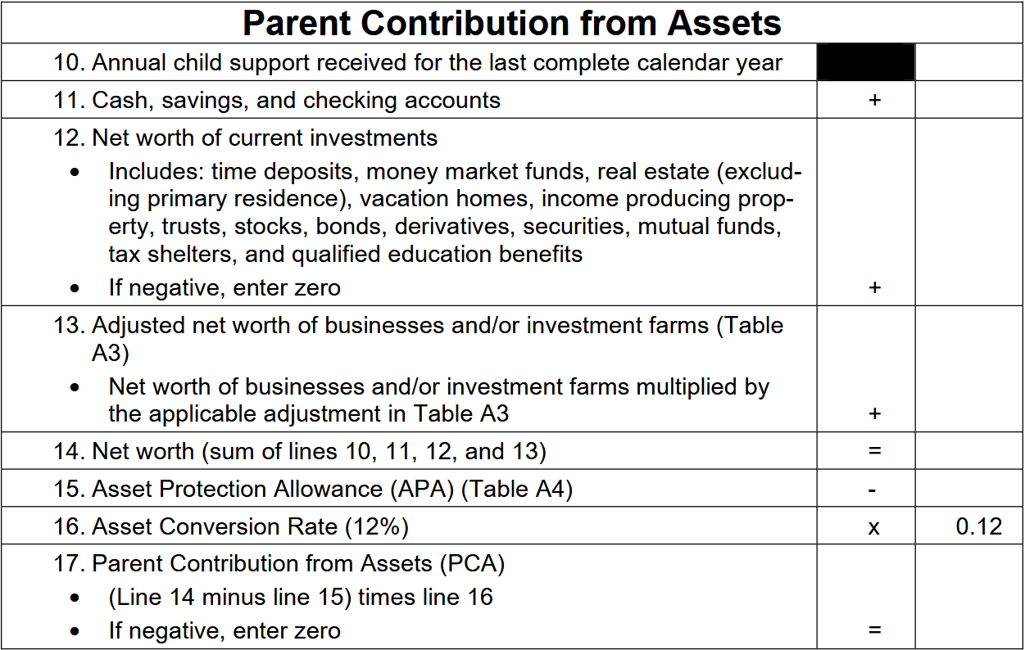
Parent Contribution From Assets
P.T. Barnam | Parents | Student
Marital Status | Married | Single
Tax Filing Status | Married-Filed Joint | Did not File
Age | 55/52 | 18
Family Size | 7
Adjusted Gross Income | $80,000 | $0
Income Earned From Work | $75,000 | $10,000
Federal Work Study | $0 | $1,500
Income Tax Paid | $5,000 | $0
Education Credits | $2,500 | $0
Untaxed Portions of IRA Distribution | $0 | $0
Deductible Payments to IRA/KEOGH/Other | $500 | $0
Tax Exempt Interest Income | $0 | $0
Untaxed Portions of Pensions | $0 | $0
Schedule C Net Profit/Loss | $0 | $0
Taxable College Grant and Scholarship Aid | $0 | $0
Foreign Income Exclusion | $0 | $0
Child Support Received | $0 | $0
Cash/Checking/Savings | $1,500 | $500
Net Worth of Business/Farm | $10,000 | $0
Net Worth of Investments | $0 | $0
0
1,500
0
Notes:
Assets are items of ownership that either have cash value or which can be converted into cash.

Slide 51
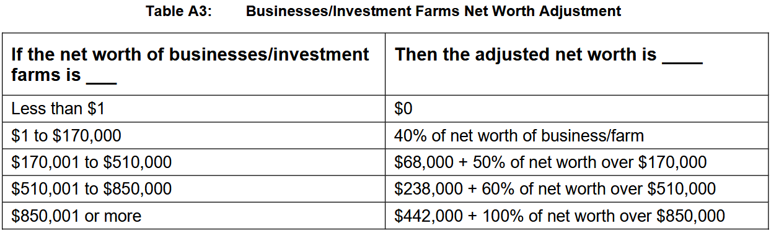
Parent Contribution From Assets
P.T. Barnam | Parents | Student
Marital Status | Married | Single
Tax Filing Status | Married-Filed Joint | Did not File
Age | 55/52 | 18
Family Size | 7
Adjusted Gross Income | $80,000 | $0
Income Earned From Work | $75,000 | $10,000
Federal Work Study | $0 | $1,500
Income Tax Paid | $5,000 | $0
Education Credits | $2,500 | $0
Untaxed Portions of IRA Distribution | $0 | $0
Deductible Payments to IRA/KEOGH/Other | $500 | $0
Tax Exempt Interest Income | $0 | $0
Untaxed Portions of Pensions | $0 | $0
Schedule C Net Profit/Loss | $0 | $0
Taxable College Grant and Scholarship Aid | $0 | $0
Foreign Income Exclusion | $0 | $0
Child Support Received | $0 | $0
Cash/Checking/Savings | $1,500 | $500
Net Worth of Business/Farm | $10,000 | $0
Net Worth of Investments | $0 | $0
10,000
x 40%
4,000

Slide 52
Parent Contribution From Assets
P.T. Barnam | Parents | Student
Marital Status | Married | Single
Tax Filing Status | Married-Filed Joint | Did not File
Age | 55/52 | 18
Family Size | 7
Adjusted Gross Income | $80,000 | $0
Income Earned From Work | $75,000 | $10,000
Federal Work Study | $0 | $1,500
Income Tax Paid | $5,000 | $0
Education Credits | $2,500 | $0
Untaxed Portions of IRA Distribution | $0 | $0
Deductible Payments to IRA/KEOGH/Other | $500 | $0
Tax Exempt Interest Income | $0 | $0
Untaxed Portions of Pensions | $0 | $0
Schedule C Net Profit/Loss | $0 | $0
Taxable College Grant and Scholarship Aid | $0 | $0
Foreign Income Exclusion | $0 | $0
Child Support Received | $0 | $0
Cash/Checking/Savings | $1,500 | $500
Net Worth of Business/Farm | $10,000 | $0
Net Worth of Investments | $0 | $0
0
1,500
0
4,000
5,500
Notes:
.

Slide 53
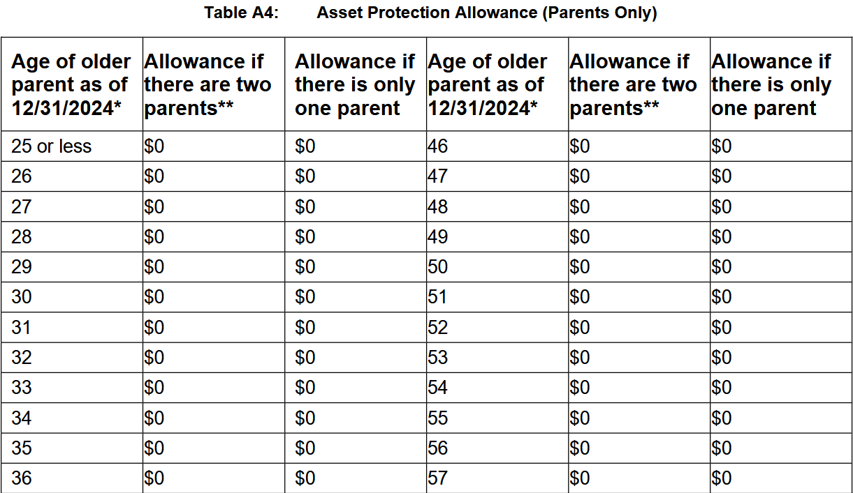
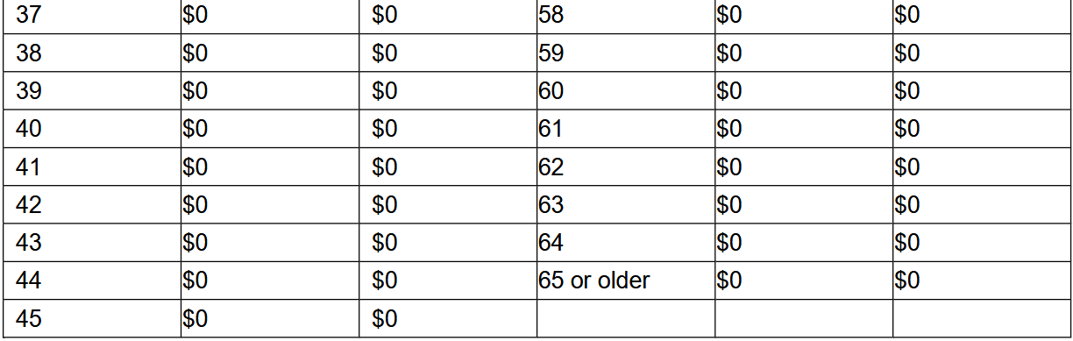
Parent Contribution From Assets
Asset Protection Allowance
Accounts for the amount an individual should have saved on their own to supplement future Social Security retirement benefits.
Will adjust each year based on multiple rates of inflation.
SSA rate > BLS rate
Average Moderate
Retirement Family Benefits Income
Standards
No Gap to Fill
P.T. Barnam | Parents | Student
Marital Status | Married | Single
Tax Filing Status | Married-Filed Joint | Did not File
Age | 55/52 | 18
Family Size | 7
Adjusted Gross Income | $80,000 | $0
Income Earned From Work | $75,000 | $10,000
Federal Work Study | $0 | $1,500
Income Tax Paid | $5,000 | $0
Education Credits | $2,500 | $0
Untaxed Portions of IRA Distribution | $0 | $0
Deductible Payments to IRA/KEOGH/Other | $500 | $0
Tax Exempt Interest Income | $0 | $0
Untaxed Portions of Pensions | $0 | $0
Schedule C Net Profit/Loss | $0 | $0
Taxable College Grant and Scholarship Aid | $0 | $0
Foreign Income Exclusion | $0 | $0
Child Support Received | $0 | $0
Cash/Checking/Savings | $1,500 | $500
Net Worth of Business/Farm | $10,000 | $0
Net Worth of Investments | $0 | $0
Notes:
APA designed to protect a portion of the family’s assets for the parents’ retirement and emergencies.
The Asset Protection Allowance is determined by the age of the older parent and whether there are 1 or 2 parents. We can find P.T.’s parent on this chart, but we see that it doesn’t matter since the entire chart has $0’s.
Intended to fill the gap between average Social Security retirement benefits and moderate family income standards.
Rate of inflation SSA (Social Security Administration) is using to increase Social Security retirement benefits is higher than the rate the BLS (Bureau of Labor Statistics) is using for it’s moderate family income standard.

Slide 54
Parent Contribution From Assets
P.T. Barnam | Parents | Student
Marital Status | Married | Single
Tax Filing Status | Married-Filed Joint | Did not File
Age | 55/52 | 18
Family Size | 7
Adjusted Gross Income | $80,000 | $0
Income Earned From Work | $75,000 | $10,000
Federal Work Study | $0 | $1,500
Income Tax Paid | $5,000 | $0
Education Credits | $2,500 | $0
Untaxed Portions of IRA Distribution | $0 | $0
Deductible Payments to IRA/KEOGH/Other | $500 | $0
Tax Exempt Interest Income | $0 | $0
Untaxed Portions of Pensions | $0 | $0
Schedule C Net Profit/Loss | $0 | $0
Taxable College Grant and Scholarship Aid | $0 | $0
Foreign Income Exclusion | $0 | $0
Child Support Received | $0 | $0
Cash/Checking/Savings | $1,500 | $500
Net Worth of Business/Farm | $10,000 | $0
Net Worth of Investments | $0 | $0
0
1,500
0
4,000
5,500
0
660
Notes:
Asset Conversion Rate – Amount of parents’ assets that are assumed to be available to contribute to the students’ educational costs
We found what assets are available, then we protected some for retirement and emergencies, and we protected more because the parents are not expected to contribute all of their assets towards post-secondary expenses

Slide 55
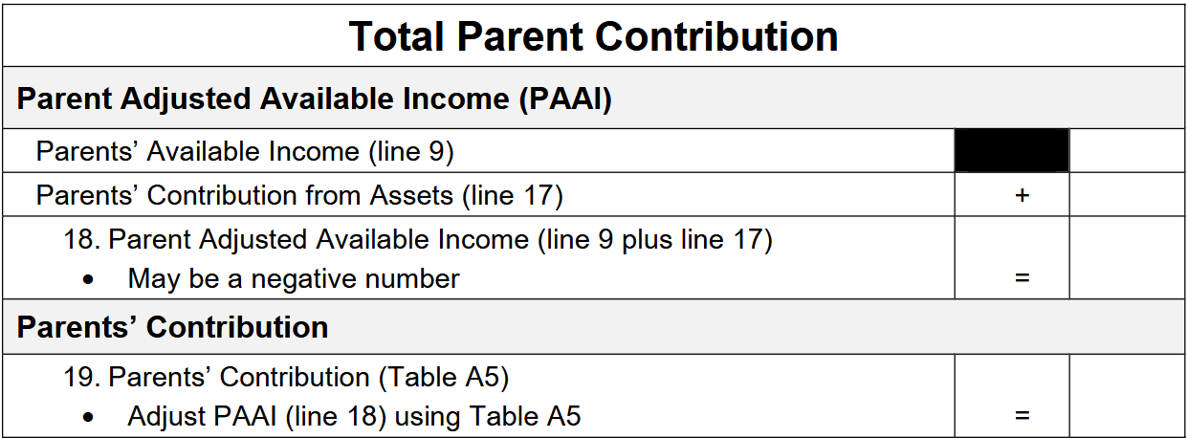
Total Parent Contribution
P.T. Barnam | Parents | Student
Marital Status | Married | Single
Tax Filing Status | Married-Filed Joint | Did not File
Age | 55/52 | 18
Family Size | 7
Adjusted Gross Income | $80,000 | $0
Income Earned From Work | $75,000 | $10,000
Federal Work Study | $0 | $1,500
Income Tax Paid | $5,000 | $0
Education Credits | $2,500 | $0
Untaxed Portions of IRA Distribution | $0 | $0
Deductible Payments to IRA/KEOGH/Other | $500 | $0
Tax Exempt Interest Income | $0 | $0
Untaxed Portions of Pensions | $0 | $0
Schedule C Net Profit/Loss | $0 | $0
Taxable College Grant and Scholarship Aid | $0 | $0
Foreign Income Exclusion | $0 | $0
Child Support Received | $0 | $0
Cash/Checking/Savings | $1,500 | $500
Net Worth of Business/Farm | $10,000 | $0
Net Worth of Investments | $0 | $0
-5,008
660
-4,348
Notes:
A negative PAAI means that the parents’ income is insufficient to cover basic living expenses. This is going to come into play when we do the student’s portion of the calculation.
Now we’ve calculated what income and assets the parents have available, and protected portions of them. Based on the PAAI, we will determine what the parent contribution can be

Slide 56
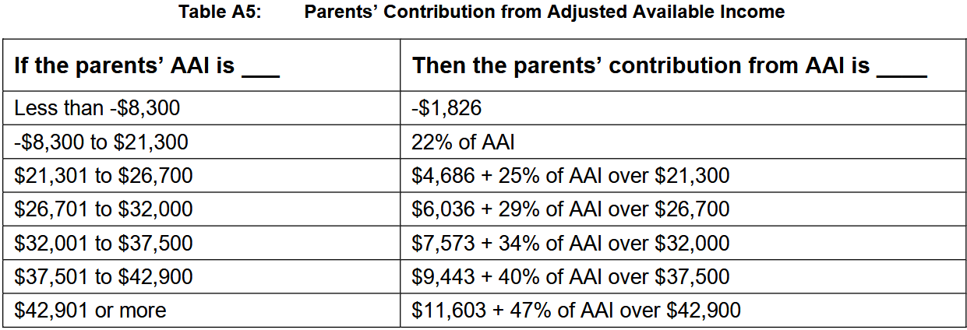
Parent Contribution From Assets
P.T. Barnam | Parents | Student
Marital Status | Married | Single
Tax Filing Status | Married-Filed Joint | Did not File
Age | 55/52 | 18
Family Size | 7
Adjusted Gross Income | $80,000 | $0
Income Earned From Work | $75,000 | $10,000
Federal Work Study | $0 | $1,500
Income Tax Paid | $5,000 | $0
Education Credits | $2,500 | $0
Untaxed Portions of IRA Distribution | $0 | $0
Deductible Payments to IRA/KEOGH/Other | $500 | $0
Tax Exempt Interest Income | $0 | $0
Untaxed Portions of Pensions | $0 | $0
Schedule C Net Profit/Loss | $0 | $0
Taxable College Grant and Scholarship Aid | $0 | $0
Foreign Income Exclusion | $0 | $0
Child Support Received | $0 | $0
Cash/Checking/Savings | $1,500 | $500
Net Worth of Business/Farm | $10,000 | $0
Net Worth of Investments | $0 | $0
-4,348

Slide 57
Total Parent Contribution
P.T. Barnam | Parents | Student
Marital Status | Married | Single
Tax Filing Status | Married-Filed Joint | Did not File
Age | 55/52 | 18
Family Size | 7
Adjusted Gross Income | $80,000 | $0
Income Earned From Work | $75,000 | $10,000
Federal Work Study | $0 | $1,500
Income Tax Paid | $5,000 | $0
Education Credits | $2,500 | $0
Untaxed Portions of IRA Distribution | $0 | $0
Deductible Payments to IRA/KEOGH/Other | $500 | $0
Tax Exempt Interest Income | $0 | $0
Untaxed Portions of Pensions | $0 | $0
Schedule C Net Profit/Loss | $0 | $0
Taxable College Grant and Scholarship Aid | $0 | $0
Foreign Income Exclusion | $0 | $0
Child Support Received | $0 | $0
Cash/Checking/Savings | $1,500 | $500
Net Worth of Business/Farm | $10,000 | $0
Net Worth of Investments | $0 | $0
-5,008
660
-4,348
-1,826
Notes:
This is the end of the parent portion, and the student portion is quick and easy, especially in situations like with our student, who didn’t file taxes.

Slide 58
Student Contribution from Income
Notes:
Again, we are finding the total, then determining what amount of that can be used towards educational costs

Slide 59
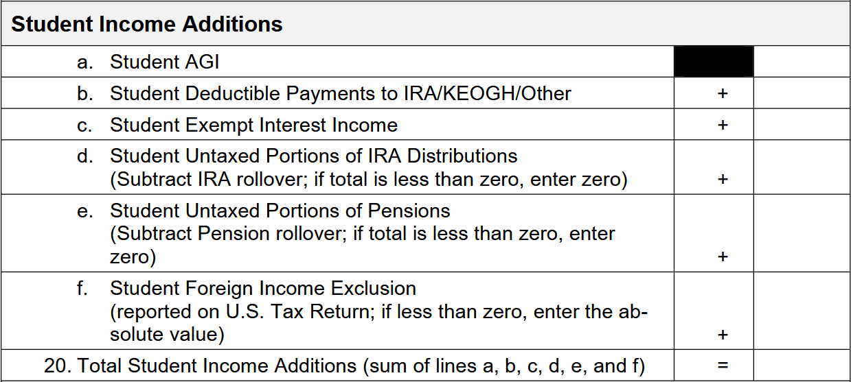
Student Contribution From Income
P.T. Barnam | Parents | Student
Marital Status | Married | Single
Tax Filing Status | Married-Filed Joint | Did not File
Age | 55/52 | 18
Family Size | 7
Adjusted Gross Income | $80,000 | $0
Income Earned From Work | $75,000 | $10,000
Federal Work Study | $0 | $1,500
Income Tax Paid | $5,000 | $0
Education Credits | $2,500 | $0
Untaxed Portions of IRA Distribution | $0 | $0
Deductible Payments to IRA/KEOGH/Other | $500 | $0
Tax Exempt Interest Income | $0 | $0
Untaxed Portions of Pensions | $0 | $0
Schedule C Net Profit/Loss | $0 | $0
Taxable College Grant and Scholarship Aid | $0 | $0
Foreign Income Exclusion | $0 | $0
Child Support Received | $0 | $0
Cash/Checking/Savings | $1,500 | $500
Net Worth of Business/Farm | $10,000 | $0
Net Worth of Investments | $0 | $0
0
0
0
0
0
0
0
Taxed and Untaxed Income available to the student
Notes:
Now we’re finding the amount of income available to the student, but because P.T. didn’t file taxes, this is pretty simple.
$10,000 is a fairly large income for an 18 year old student, so if we’re questioning whether he needs to file taxes, we can check:

Slide 60
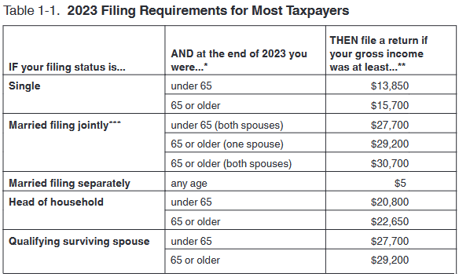
Student Contribution From Income
P.T. Barnam | Parents | Student
Marital Status | Married | Single
Tax Filing Status | Married-Filed Joint | Did not File
Age | 55/52 | 18
Family Size | 7
Adjusted Gross Income | $80,000 | $0
Income Earned From Work | $75,000 | $10,000
Federal Work Study | $0 | $1,500
Income Tax Paid | $5,000 | $0
Education Credits | $2,500 | $0
Untaxed Portions of IRA Distribution | $0 | $0
Deductible Payments to IRA/KEOGH/Other | $500 | $0
Tax Exempt Interest Income | $0 | $0
Untaxed Portions of Pensions | $0 | $0
Schedule C Net Profit/Loss | $0 | $0
Taxable College Grant and Scholarship Aid | $0 | $0
Foreign Income Exclusion | $0 | $0
Child Support Received | $0 | $0
Cash/Checking/Savings | $1,500 | $500
Net Worth of Business/Farm | $10,000 | $0
Net Worth of Investments | $0 | $0
IRS Publication 17
Notes:
IRS Publication 17
P.T. is Single, and under 65, so as long as he made less than $13,850 he was not required to file in 2023

Slide 61
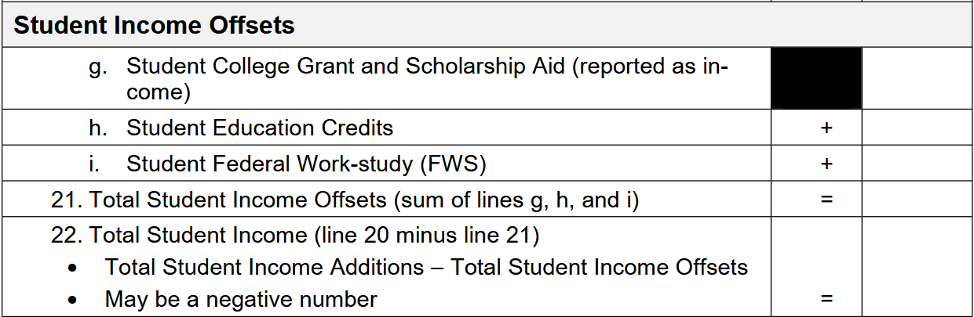
Student Contribution From Income
P.T. Barnam | Parents | Student
Marital Status | Married | Single
Tax Filing Status | Married-Filed Joint | Did not File
Age | 55/52 | 18
Family Size | 7
Adjusted Gross Income | $80,000 | $0
Income Earned From Work | $75,000 | $10,000
Federal Work Study | $0 | $1,500
Income Tax Paid | $5,000 | $0
Education Credits | $2,500 | $0
Untaxed Portions of IRA Distribution | $0 | $0
Deductible Payments to IRA/KEOGH/Other | $500 | $0
Tax Exempt Interest Income | $0 | $0
Untaxed Portions of Pensions | $0 | $0
Schedule C Net Profit/Loss | $0 | $0
Taxable College Grant and Scholarship Aid | $0 | $0
Foreign Income Exclusion | $0 | $0
Child Support Received | $0 | $0
Cash/Checking/Savings | $1,500 | $500
Net Worth of Business/Farm | $10,000 | $0
Net Worth of Investments | $0 | $0
0
0
1,500
1,500
0
- 1,500
-1,500
Income that is subtracted out of the calculation
These items are removed, or offset, to avoid penalizing families for utilizing resources intended to make college more affordable.
Notes:
Again, we are removing these amounts from the calculation because we do not want to punish the student for utilizing programs that are intended to make college more affordable

Slide 62
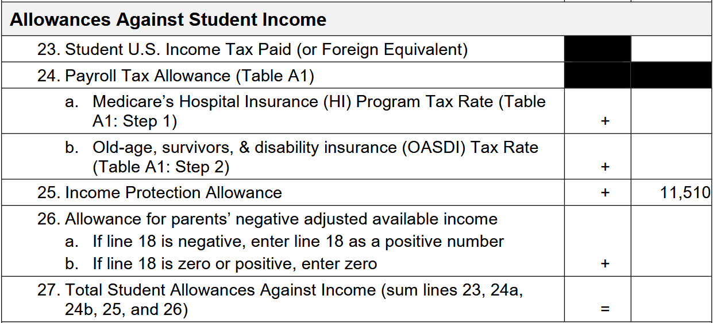
Student Contribution From Income
P.T. Barnam | Parents | Student
Marital Status | Married | Single
Tax Filing Status | Married-Filed Joint | Did not File
Age | 55/52 | 18
Family Size | 7
Adjusted Gross Income | $80,000 | $0
Income Earned From Work | $75,000 | $10,000
Federal Work Study | $0 | $1,500
Income Tax Paid | $5,000 | $0
Education Credits | $2,500 | $0
Untaxed Portions of IRA Distribution | $0 | $0
Deductible Payments to IRA/KEOGH/Other | $500 | $0
Tax Exempt Interest Income | $0 | $0
Untaxed Portions of Pensions | $0 | $0
Schedule C Net Profit/Loss | $0 | $0
Taxable College Grant and Scholarship Aid | $0 | $0
Foreign Income Exclusion | $0 | $0
Child Support Received | $0 | $0
Cash/Checking/Savings | $1,500 | $500
Net Worth of Business/Farm | $10,000 | $0
Net Worth of Investments | $0 | $0
0
0
0
-4,348
4,348
15,858
Money not available to pay for educational expenses because it is already being used for other purposes.
Notes:
Now we calculate the allowances against the students’ income.
Again, P.T. did not file, so he has no taxes paid amount, he also does not use the Payroll Tax Allowance
We’ll notice here the IPA is a fixed amount for the student, as opposed to the parents’ IPA, where we used a chart based on the family size.
We also do not have the Employment Expense Allowance for the student, where we had that to account for parent job related expenses.
We do have a new amount that the parent did not have. That amount is the Allowance for parents’ negative adjusted available income. P.T.’s parents adjusted available income was negative, this means their income is insufficient to cover basic living expenses for the family. Because of this P.T. may be needed to help support the family. Because of this, we enter the negative amount for the parents here as a positive amount.

Slide 63
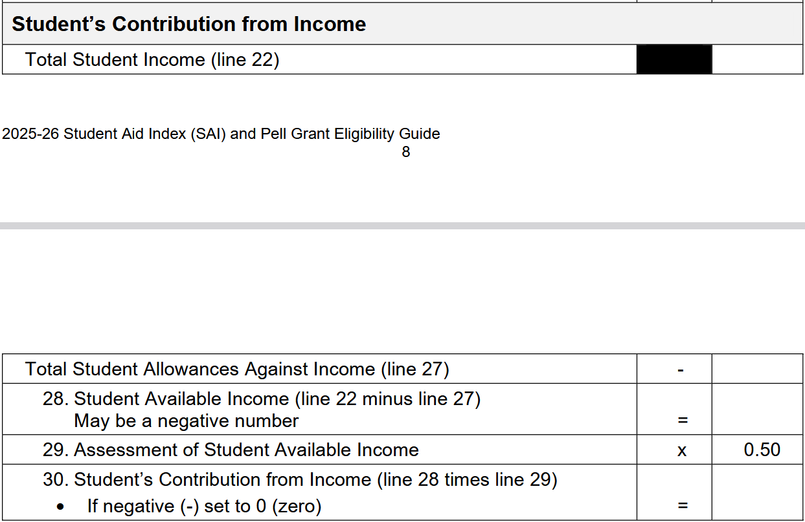
Student Contribution From Income
P.T. Barnam | Parents | Student
Marital Status | Married | Single
Tax Filing Status | Married-Filed Joint | Did not File
Age | 55/52 | 18
Family Size | 7
Adjusted Gross Income | $80,000 | $0
Income Earned From Work | $75,000 | $10,000
Federal Work Study | $0 | $1,500
Income Tax Paid | $5,000 | $0
Education Credits | $2,500 | $0
Untaxed Portions of IRA Distribution | $0 | $0
Deductible Payments to IRA/KEOGH/Other | $500 | $0
Tax Exempt Interest Income | $0 | $0
Untaxed Portions of Pensions | $0 | $0
Schedule C Net Profit/Loss | $0 | $0
Taxable College Grant and Scholarship Aid | $0 | $0
Foreign Income Exclusion | $0 | $0
Child Support Received | $0 | $0
Cash/Checking/Savings | $1,500 | $500
Net Worth of Business/Farm | $10,000 | $0
Net Worth of Investments | $0 | $0
-1,500
15,858
-17,358
-8,679
0
Student Available Income = Income available for discretionary purposes
Assessment of Student Available Income = Portion of student income available for paying for a postsecondary education
Notes:
Our assessment of available income is 50%, this is the portion of the student’s income that the formula considers available for a student to put towards their postsecondary education

Slide 64
Student Contribution from Assets
Notes:
Next, the Contribution from Assets
Again, we are finding the total, then determining what amount of that can be used towards educational costs

Slide 65
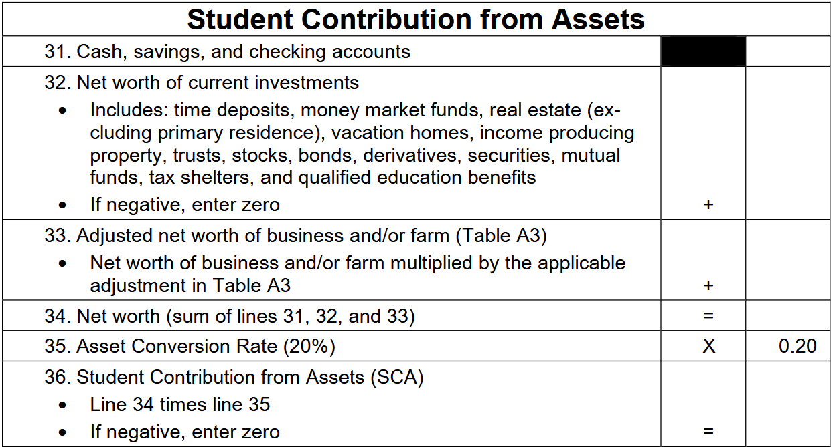
Student Contribution From Assets
P.T. Barnam | Parents | Student
Marital Status | Married | Single
Tax Filing Status | Married-Filed Joint | Did not File
Age | 55/52 | 18
Family Size | 7
Adjusted Gross Income | $80,000 | $0
Income Earned From Work | $75,000 | $10,000
Federal Work Study | $0 | $1,500
Income Tax Paid | $5,000 | $0
Education Credits | $2,500 | $0
Untaxed Portions of IRA Distribution | $0 | $0
Deductible Payments to IRA/KEOGH/Other | $500 | $0
Tax Exempt Interest Income | $0 | $0
Untaxed Portions of Pensions | $0 | $0
Schedule C Net Profit/Loss | $0 | $0
Taxable College Grant and Scholarship Aid | $0 | $0
Foreign Income Exclusion | $0 | $0
Child Support Received | $0 | $0
Cash/Checking/Savings | $1,500 | $500
Net Worth of Business/Farm | $10,000 | $0
Net Worth of Investments | $0 | $0
500
0
0
500
100
Notes:
For the student portion, we remove the child support received question, because, if our student was supporting a child, they would not be at Circus A.
We also remove the asset protection allowance, that was our chart that was all 0’s. We don’t have it for the student because we don’t expect them to be saving for emergencies and retirement like we do of their parent.
We also raise the Asset Conversion Rate from the 12% we used for parents, up to 20% for students, again because dependent students are not expected to provide for retirement or emergencies at this point.

Slide 66
Parent Contribution from Income
Parent Contribution from Assets
Parent Contribution
Student Contribution from Income
Student Contribution from Assets
Student Contribution
Student Aid Index
Notes:
We’ve found all the pieces of this puzzle, all that’s left is to put them together!

Slide 67
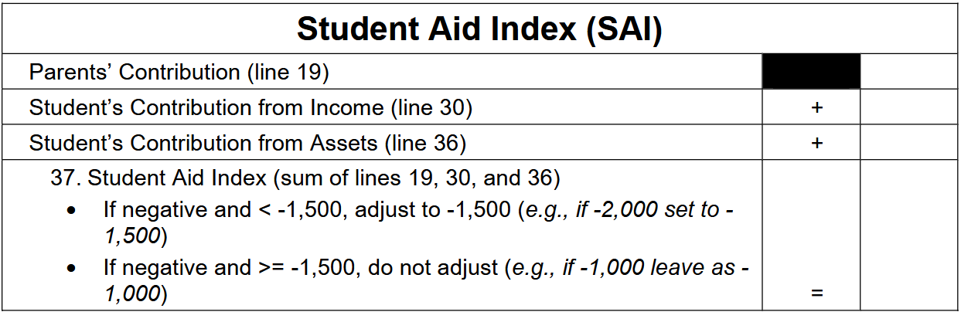
Student Aid Index
P.T. Barnam | Parents | Student
Marital Status | Married | Single
Tax Filing Status | Married-Filed Joint | Did not File
Age | 55/52 | 18
Family Size | 7
Adjusted Gross Income | $80,000 | $0
Income Earned From Work | $75,000 | $10,000
Federal Work Study | $0 | $1,500
Income Tax Paid | $5,000 | $0
Education Credits | $2,500 | $0
Untaxed Portions of IRA Distribution | $0 | $0
Deductible Payments to IRA/KEOGH/Other | $500 | $0
Tax Exempt Interest Income | $0 | $0
Untaxed Portions of Pensions | $0 | $0
Schedule C Net Profit/Loss | $0 | $0
Taxable College Grant and Scholarship Aid | $0 | $0
Foreign Income Exclusion | $0 | $0
Child Support Received | $0 | $0
Cash/Checking/Savings | $1,500 | $500
Net Worth of Business/Farm | $10,000 | $0
Net Worth of Investments | $0 | $0
-1,826
0
100
-1,726
-1,500

Slide 68
A
B
C
Parent Contribution from Income
Parent Income Additions
Parent Income Offsets
Parent Contribution from Assets
Parent Adjusted Available Income
Parent Contribution
Allowances Against Parents’ Income
Parents’ Available Income
Total Parent Contribution
Student Contribution from Income
Student Income Additions
Student Income Offsets
Student Contribution from Assets
Parent Contribution
Student Contribution from Income
Allowances Against Students’ Income
Student’s Contribution from Income
Student Aid Index
Student Contribution from Assets
Student Contribution from Income
Student Income Additions
Student Income Offsets
Student Contribution from Assets
Student Contribution from Income
Student Contribution from Assets
Allowances Against Student Income
Student’s Contribution from Income
Student Aid Index
Student Contribution from Income
Student Income Additions
Student Income Offsets
Student Contribution from Assets
Student Contribution from Income
Student Contribution from Assets
Allowances Against Student Income
Student’s Available Income
Student Aid Index
Notes:
Again, we only looked at Formula A, but if we would have compared to B and C, we would have found Formula C extremely similar to the parent portion of A and Formula B extremely similar to the student portion.
We could also look at this as the formulas for those with or those without dependents.
The main differences are the percentages used in are tables and calculations.

Slide 69
That’s All Folks!

Slide 70
Resources
2025-26 Student Aid Index (SAI) and Pell Grant Eligibility Guide
IRS Publication 17: 2023
Pell Eligibility/SAI Process Flow Chart
2023 Poverty Guidelines
Notes:
Here are some helpful resources you can access,

